Slide 1
AllLifeBank Customer Segmentation
Anisah Inua Mohammed

Slide 2
Description
AllLife Bank wants to focus on its credit card customer base in the next financial year. They have been advised by their marketing research team, that the penetration in the market can be improved. Based on this input, the Marketing team proposes to run personalised campaigns to target new customers as well as upsell to existing customers. Another insight from the market research was that the customers perceive the support services of the back poorly. Based on this, the Operations team wants to upgrade the service delivery model, to ensure that customers queries are resolved faster. Head of Marketing and Head of Delivery both decide to reach out to the Data Science team for help

Slide 3
Objective
To identify different segments in the existing customer based on their spending patterns as well as past interaction with the bank.

Slide 4
Data Description:
Data is of various customers of a bank with their credit limit, the total number of credit cards the customer has, and different channels through which customer has contacted the bank for any queries, different channels include visiting the bank, online and through a call centre.

Slide 5

Multivariate Analysis and Outlier

Slide 6
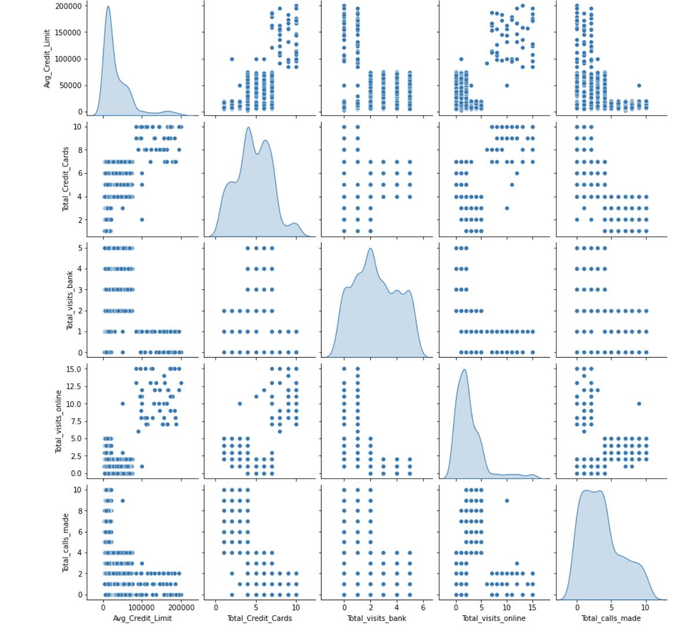
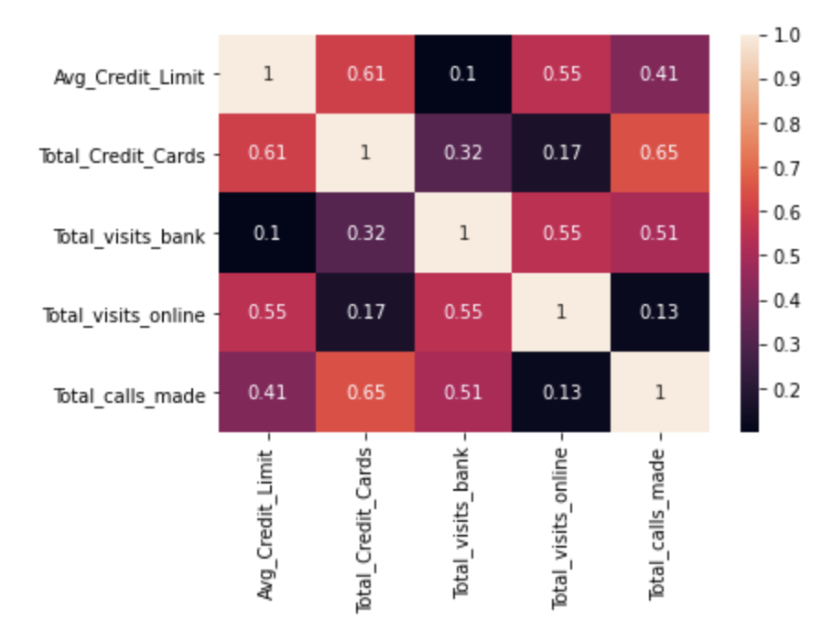

Slide 7
Observations
this shows that there are 660 rows and 7 columns.
All the features have integer values based on the above output
This shows that there are no missing values in this dataset
Looks like there is there some duplication in the customer key however no rows are duplicated
Now we are going to delete SI_No and Customer because there is redundancy in those columns

Slide 8
Observations From the Multivariate Analysis and Outlier Detection
The kde plots display the frequency of peak values of each feature.
The peak in each of the kde plots displays the mode and how approximately the guessed number of distinct clusters any specific feature forms.
It also shows that Avg_Credit_Limit shows 3 while Total_Credit_Cards shows 4, Total_visits_bank sows 3 Total_visits_online shows 3 and Total_call_made shows 2 peaks which indicates minimum number of probable separate clusters.
There is no significant correlation observed among the different features
It shows that there is no strong linear relationship between any of the features/variable
Avg credit limit, total visits online and total calls made are positively skewed
Total credit cards and total visits to the bank are more normalized.
The diagonal of the pairplot we can assume the data to be a mixture of gaussians , looing at the peaks of the gaussians we can say that the optimal number might come between 2-3

Slide 9
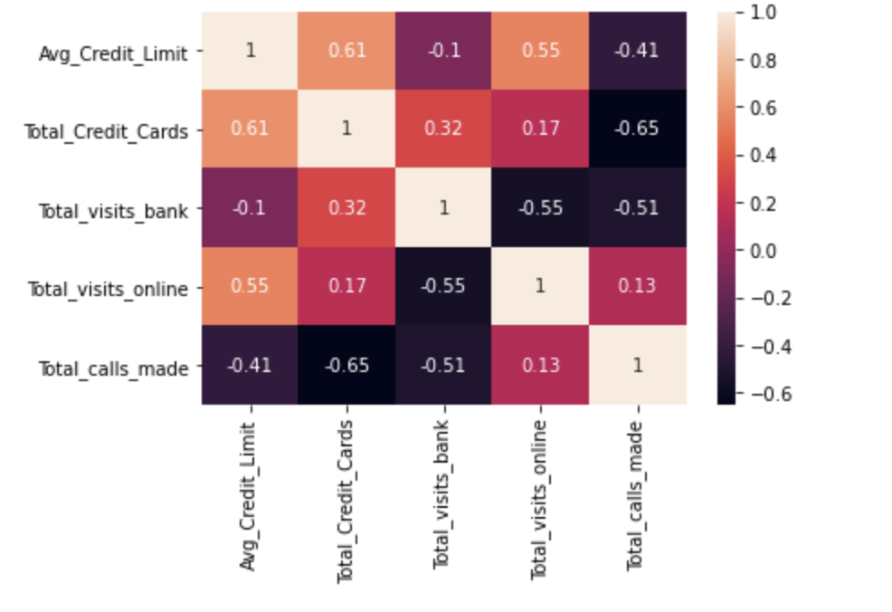
Scaling the data
Transforming your data so that it fits within a specific scale

Slide 10
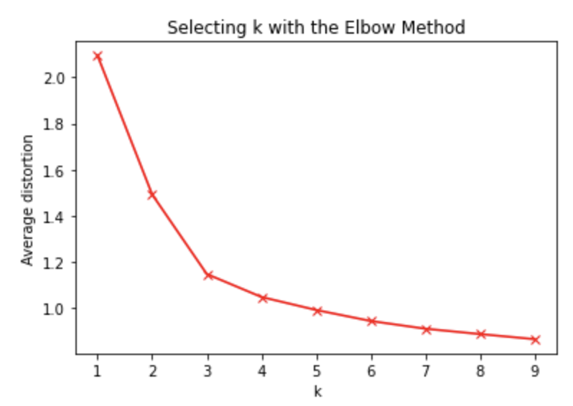
Elbow Method and K-means clustering
This elbow graph shows that the bend above 3 or 4 clusters looks like a perfect value.
This indicates most optimum number of clusters for this data is 3.
Now we can take K=3 , so let's apply Kmeans with k=3
Here we shall be using 3 clusters

Slide 11
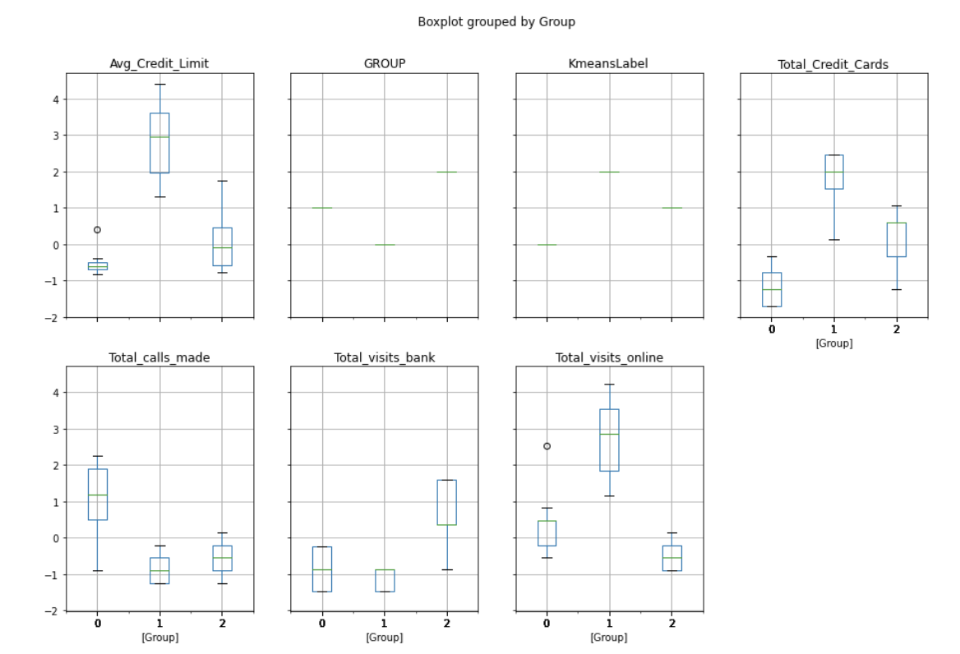
The customers that have an average credit limit that is less than 100,000 are rarely online also visit the bank less often
While customers who have an average credit limit that is above 100,000 are mostly always online and visit the bank more often

Slide 12
Silhouette plot on K-Means clustering
The silhouette score is maximum when the total number of clusters is 3
The score decreases when the clusters increase or decrease indicating that 3 is the optimum number
Some samples are having negative silhouette score when number of clusters = 2,5,6 signifying it is being assigned in a wrong cluster.

Slide 13
Hierarchical Clustering
This shows that the best cophenetic coefficient we get is for "Average" linkage.
Looking at dendrogram 'ward' and 'complete' show good difference between clusters.
Choosing 'complete' because it has high cophenetic coefficient and good cluster segregation.

Slide 14
Comparison between K-means and Hierarchical clustering
Cluster 0 of Kmeans appears similar to Cluster 2 of Hierarchical
Cluster 1 of Kmeans appears similar to Cluster 3 of Hierarchical
Cluster 2 of Kmeans appears similar to Cluster 1 of Hierarchical
Now we will rename our clusters
Cluster 0 of Kmeans and Cluster 2 of Hierarchical as M1
Cluster 1 of Kmeans and Cluster 3 of Hierarchical as M2
Cluster 2 of Kmeans and Cluster 1 of Hierarchical as M3

Slide 15
Cluster Profiles and Marketing Recommendation
Since both the clustering algorithms are giving similar clusters so we can assign labels from any one of the algorithm to the original (non scaled) data to analyse clusters profiles ( here we are assigning labels of Kmeans , same could be done using hierarchical labels)

Slide 16

Clusters Profiles

Slide 17
Label 0 can be considered low valued customers
This group comprises of about 34% of the customers ( 224/660 )
These customers have a mean "Avg_Credit_Limit " around 12200 and have 2 credit card on an average and the maximum number of credit card as 4.
They are the ones who makes the most number of customer care calls to the bank as the average calls made is 7

Slide 18
Label 1 can be considered medium valued customers
This group forms the majority of the customers having about 58% customers in total ( 386/660 )
These customers have "Avg_Credit_Limit " ranging from 5000.0 to 100000.0
These are the ones which make the maximum number of visits to the bank as the average visits to bank is 3.
They are the ones who are least active online as the maximum visit onine is just 3

Slide 19
Label 2 can be considered high value customers
These are the least in number i.e. only 50 customers comprising 7.5% of total customers (50/660) .
These customers have a minimum "Avg_Credit_Limit " of 84000 and have atleast 5 Credit cards .
These are the ones which make the minimum number of visits to the bank as the maximum visit to bank is 1 amongst all 50 customers.
They are mostly using online services as the average visit online is 11.

Slide 20
Business Recommendation
Customers in the medium group (Label 1). They rarely participate in online activities, and one of the exercises may be to get them to participate online. If they register online, promotions and offers can be easily communicated to them.
Customers in low group (label 0).It can also be classified to check whether there are extreme groups with higher average credit lines. These customers can get more discounts and new credit cards so that we can include them in the middle group (label 1 ) over a period of time. Similarly, we can do this for medium clients (label 1) and try to place them in the advanced group (label 2) over a period of time .
Customers in low group (label 0). As the most frequent call centre caller, you can try to deliver various offers to these customers and transition into a mid-sized group over a period of time.

Slide 21

Thank You
Anisah Inua Mohammed

